Slide 1
Objectives
Define the Problem
Gather Data
Pre-process the Data
Feature Selection/Engineering
Choose a Machine Learning Algorithm
Train & Test Model
Evaluate the Model

Slide 2
Need of Stock Market Prediction
Decision Making
Risk Management
Market Analysis
Algorithmic Trading
Forecasting Market Trends
Financial Planning
Quantitative Research

Slide 3
Abstract
Stock market prediction using machine learning has garnered significant attention in recent years due to its potential to enhance investment decision-making and improve financial outcomes. The objective is to develop predictive models that capture the inherent complexity and nonlinearity of financial markets, enabling accurate predictions of future stock prices, trends, and volatility. The research begins with data collection, gathering historical stock market data, financial indicators, news sentiment, and macroeconomic factors. Pre-processing techniques are applied to clean the data, handle missing values, and normalize numerical features. Various machine learning algorithms, including LSTM(long-short term memory), SVM(support vector machines), RF(random forests), are evaluated for their ability to built model. The trained models are rigorously evaluated using testing datasets, employing metrics such as accuracy, mean squared error, and financial indicators specific to stock market prediction. The finally results are compared to get best fitted model for predictions on unseen data, enabling users to gain insights into future market trends, identify investment opportunities, and manage risks effectively.

Slide 4
Work Flow
DataSource
Preprocessing
Prediction
1.Feature Extraction
2.Outlier Removal
3.Handle Missing Values
4.Normalization
LSTM
SVM
RF
NSE
Training Machine Learning Algorithm
Testing Machine Learning Algorithm
Yahoo Finance
Final Dataset
Compare (LSTM,SVM,RF)
Results and Analysis
End

Slide 5
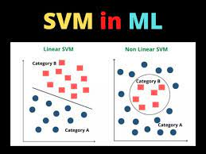
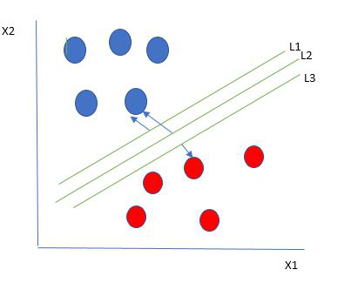
Methodology
2. SVM (Support Vector Machine)
Used for classification & regression problem.
Create best decision boundary i.e. Hyperplane.
Types of SVM
Linear SVM: dataset classified into classes by using single straight line.
Non-Linear SVM: dataset cannot be classified by using straight line.
Advantages:
More effective in high dimensional space.
Gives clear margin of separation between classes.
Limitations:
Not suitable for large dataset.

Slide 6
Features
Open : tells the price at which a stock started .
Close : refers to the price when the stock exchange closed the market.
High : depicts the highest price at which a stock traded during a period.
Low : tells the lowest price of the period.
Volume : total amount of trading activity during a period of time.
Prev_Close : tells price of preceding time period.
Date : first business day after the stock dividend is paid

Slide 7
Variables
Dependent Variable : Y-axis is a dataset holds dependent variable.
“Close”
Independent Variable : X-axis is a dataset holds independent variable.
“High”
“Low”
“Open”
“Prev_Close”
“Volume”

Slide 8
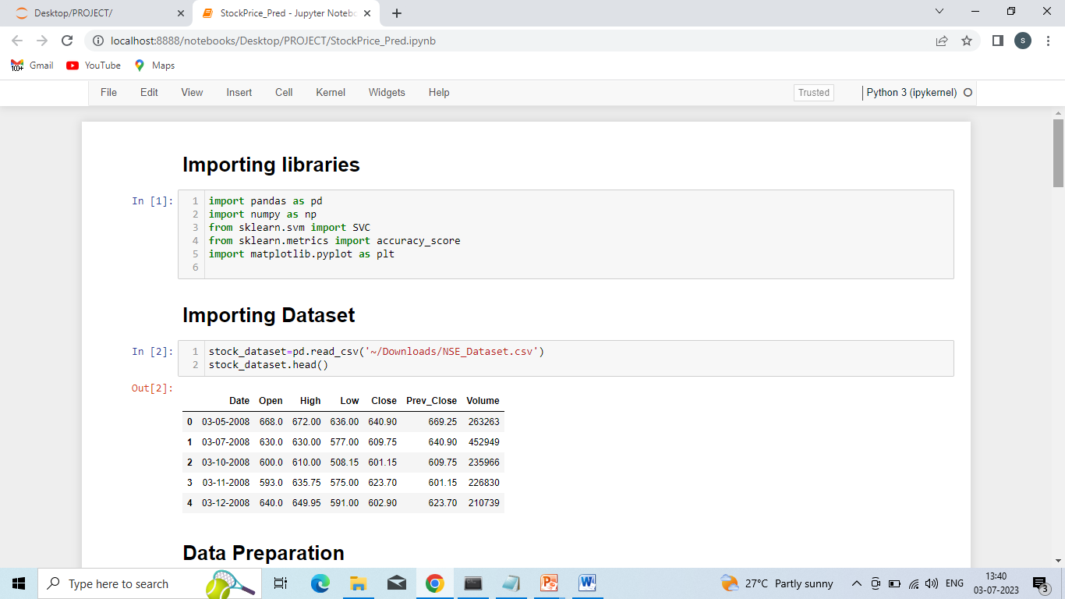
Importing Libraries

Slide 9
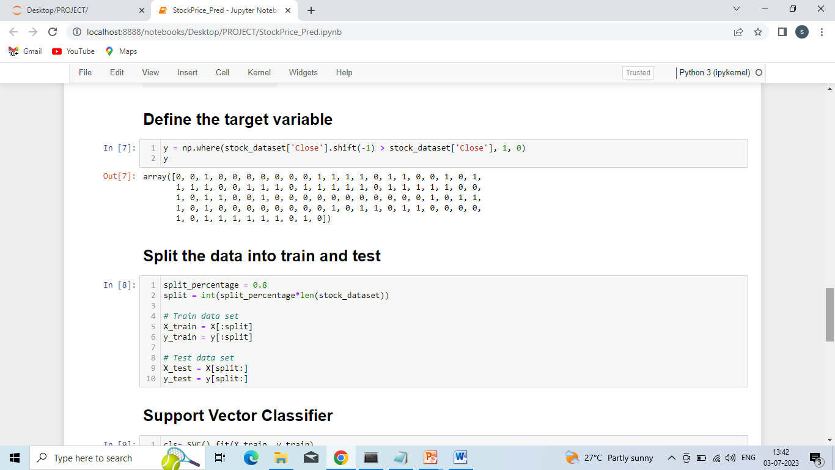
Train & Test Data

Slide 10


Accuracy According Features
Features are : “Open”, “High”, “Low”, “Prev_Close”
Accuracy : 0.48233
Features are : “Open” , “High”, “Low” , “Prev-Close”, “Volume”
Accuracy: 0.52222

Slide 11
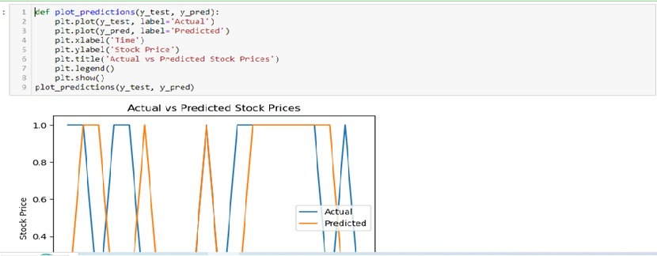
Graph

